Slide 2


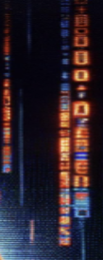
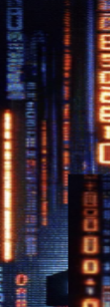

Notes:
If you’re a social media company, in this case Reddit that’s preparing for it’s IPO next month, you want to show that your users are real and gain the trust of institutional investors. So reddit management wants to get rid of bots. But if you’re Reddit and can’t even pay your own moderators, who are you gonna call?

Slide 3

Detecting Bots in r/Place
Techniques used to capture different types of bots and users.
High frequency with:
Single coordinate placements
Low time variance
Single color placement
Other anomalies

Slide 4
Detecting ADMINS
Methodology:
Found time differences between each pixel placed by a user
Filtered by time differences less than four minutes and users that placed 25 tiles within the time difference parameter
Findings:
109 unique admin users found
53,580 pixels placed by admins
~.04% of pixels placed by admins

Slide 5
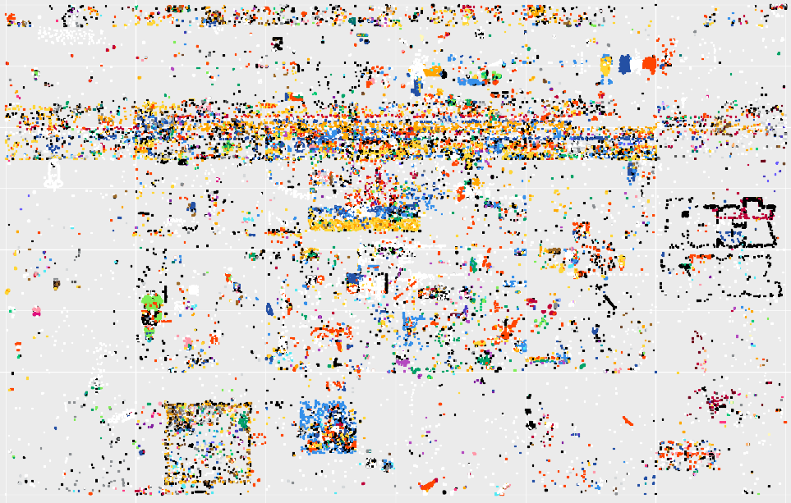

Slide 6
Looking into Spam Bots
Methodology:
Found time differences between each pixel placed by a user
Removed 80th quantile of time differences
Filtered by SD less than 30s, or Median less than 2.5min with more than 20 placements.
Findings:
130k unique users found
8,739,479 pixels placed by these users
Disclaimers:
SD filter high
Median overlaps with other analysis

Slide 7
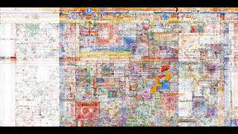
Timelapse
Grouped into 15 minute segments
Most recent tile placed
Utilized both Tuukka and Ben’s bot detection methods
Ben bot detection:
Created x and y coordinate bins, grouped by minutes
Calculated pixels placed per minute in each bin
Selected users in bins with >25% of the pixels placed in a minute
Inner joined with Tuukka’s list of users
Outer joined with suspected admins to remove admins

Slide 8


PRESENTER NAME

